Slide 1
USRP FPGA project Pulse detector
Chaim bloch

Slide 2
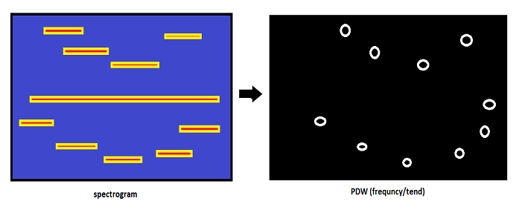
Pulse detector – main goal
Taking a spectrogram and summaries it to short simple data that describe the spectrum as simply as it can.
Assuming:
Pulse keeps his amplitude the same (in a small range) for all his duration.
Pulse can be transmitted on all frequencies in range.

Slide 3
Pulse detector – output
Array of pulses
Frequency
Toff
Duration (long pulses – chop them to some shorter once)
AMP
spectrogram

Slide 4
Pulse detector– basic blocks
IQ stream
Peak detect
Host comp
windowing
FFT
PDW creator
network
WOLA4
Blackman

Slide 5
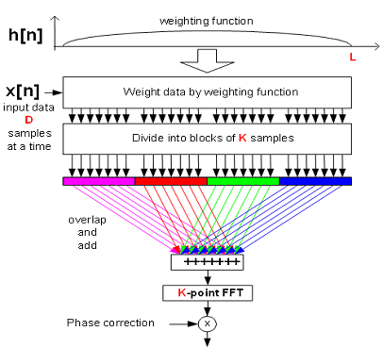
Pulse detector– basic blocks – windowing - WOLA4
Every sample in the entrance of the FFT is a sun of 4 windowed samples:
Xn ,Xn+4096 ,Xn+8192 ,Xn+12288
2 memory sectors each with 0.25 of the window (0-0.25,0.25-0.5)
Symmetrically of the window make the NOT(index) the index for the rest of the window (wind0-0.25(not(n)= wind0.75-1(n+12288))

Slide 6
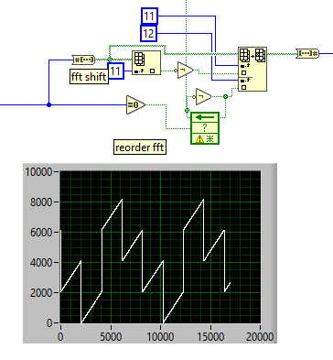
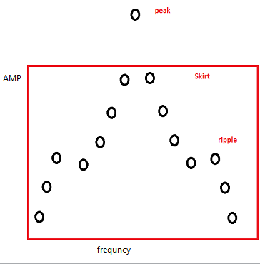
Pulse detector– basic blocks –peak detect
Reorder the samples and FFT shift
Peak detect – remove skirt don’t remove ripple

Slide 7
Pulse detector– basic blocks –spot gen
Calculate amplitude (mean amp of the 2-9 detections (0,1 detections considered to be the rising time))
Calculate length
Closes gaps
Chop CW’s
Send approved pulses

Slide 8
demonstration

Slide 9
Code deep dive

